Slide 1
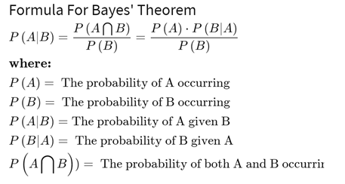
Introduction
Bayes theorem is a theorem in probability and statistics, named after the Reverend Thomas Bayes, that helps in determining the probability of an event that is based on some event that has already occurred.
The theorem was discovered among the papers of the English Presbyterian minister and mathematician Thomas Bayes and published posthumously by being read to the Royal Society in 1763.

Slide 2
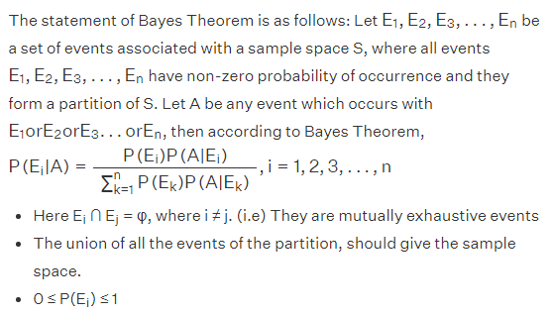

Slide 3
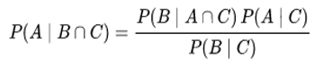
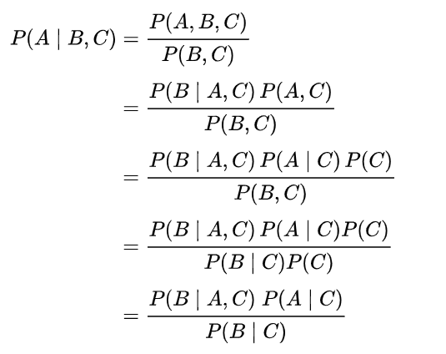
Bayes’ Theorem For Two Evidences
A conditioned version of the Bayes’ theorem results from the addition of a third event ‘C’ on which all probabilities are conditioned.
Formula for more than two evidence can also be derived.

Slide 4
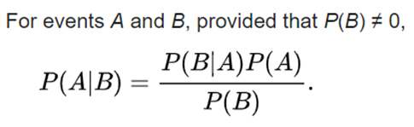
Different forms of Bayes’ formula
1. Simple Form:

Slide 5
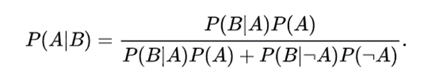
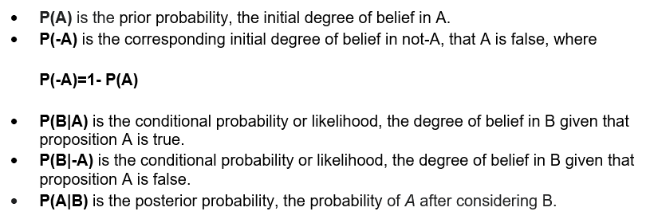
2. Alternative form:

Slide 6
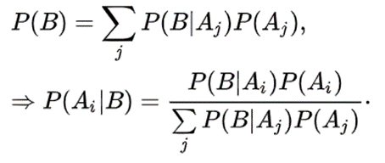
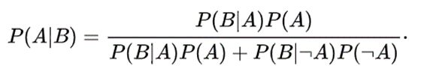
3. Extended form:
Often, for some partition {A_{j}} of the sample space, the event space is given in terms of P(A_{j}) and P(B | A_{j}). It is then useful to compute P(B) using the law of total probability:
In the special case where A is a binary variable:

Slide 7
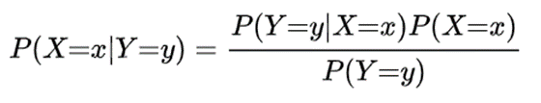
4. Random variables:
Consider a sample space Ω generated by two random variables X and Y. In principle, Bayes' theorem applies to the events A = {X = x} and B = {Y = y}.

Slide 8
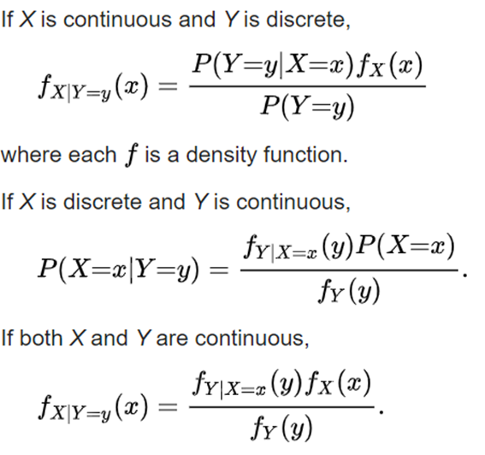
a. Simple form:

Slide 9
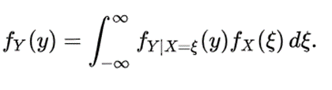
b. Extended form:
A continuous event space is often conceptualized in terms of the numerator terms. It is then useful to eliminate the denominator using the law of total probability. For f_{Y}(y), this becomes an integral:

Slide 10

Bayes’ theorem using Venn diagrams
Blue/Orange/Yellow: conditions given to support the prior knowledge and increase the probability of a given event.
Their intersection represents the surety/probability of an event to occur, the lesser the intersection is, more accurate will be the guess (probability will be high).

Slide 11
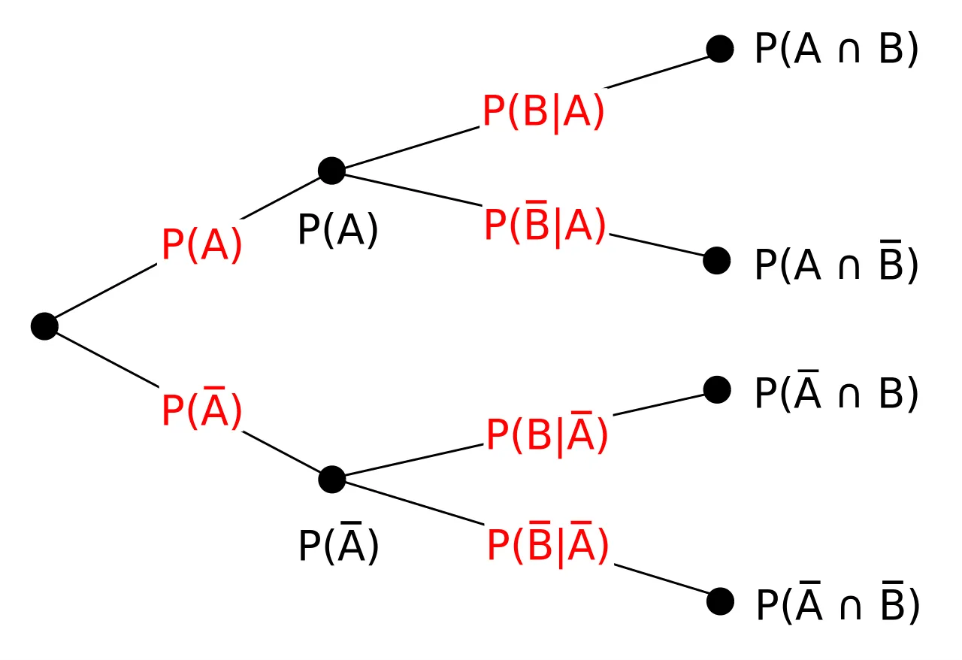
Bayes’ theorem using tree diagram

Slide 12
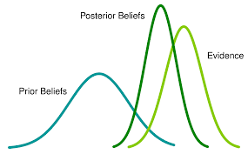
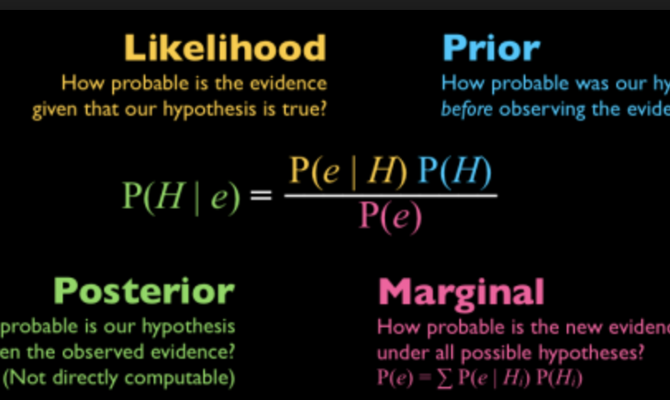
Applications of bayes’ theorem
Applications of Bayes' Theorem are widespread and not limited to the financial realm. For example, Bayes' theorem can be used to determine the accuracy of medical test results by taking into consideration how likely any given person is to have a disease and the general accuracy of the test. Bayes' theorem relies on incorporating prior probability distributions in order to generate posterior probabilities.
Applications of Bayes’ theorem are widespread in the world around us.
Few of them are as follows:

Slide 13
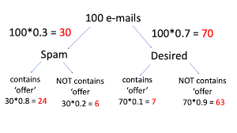
Credit card fraud detection: Bayesian inference can identify patterns or clues for credit card fraud by analysing the data and inferring probabilities with Bayes’ theorem. Credit card fraud detection may have false positives due to incomplete information. After an unusual activity is reported to enterprise risk management, Bayesian neural network techniques are used on the customer profile dataset that includes each customer’s financial transactions over time. These analyses confirm whether there are any indications of fraudulent activities.
Spam filtering: Bayesian inference allows for the identification of spam messages by using Bayes’ theorem to construct a model that can tell if an email is likely to be spam or not. The Bayesian model trained using the Bayesian algorithm will take each word in the message into account and give it different weights based on how often they appear in both spam and non-spam messages. Bayesian neural networks are also used to classify spam emails by looking at the probability of an email being spam or not based on features like number of words, word length, presence/absence of particular characters etc.

Slide 14
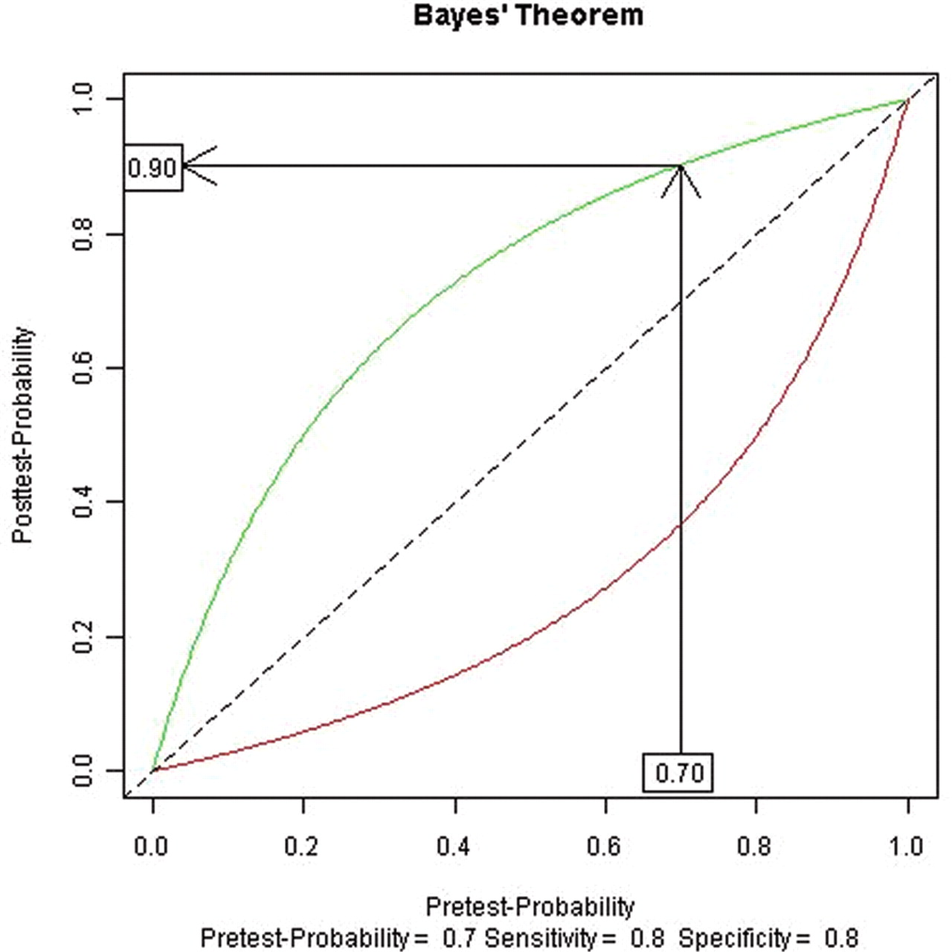
Forensic analysis: Bayesian inference can be used in Bayesian machine learning to infer the identity of an individual based on DNA evidence. Bayes’ theorem is applied for forensic analysis, which involves reasoning about conditional probabilities and making statistical inferences from observed data (genetic marker alleles) with respect to one or more populations of possible genotypes under study.
Federated analytics (Faulty device detection, malfunctions): Bayesian approach can be applied to federated analytics, a new approach to data analytics involving an integrated pipeline of machine learning techniques. The Bayesian hierarchical model allows the user to interrogate the aggregated model and automatically detect anomalies that could indicate faulty devices, malfunctions, or other such problems with remote assets/sensor networks. Federated learning is the methodology that provides a means of decentralized computations for machine learning without a need for moving local data of users. In each round of the federated learning, the participating devices train a model on their respective local data and send only an encrypted update to the aggregator. The aggregator combines updates from all participants to improve a shared model followed by its distribution to all participants.

Slide 15
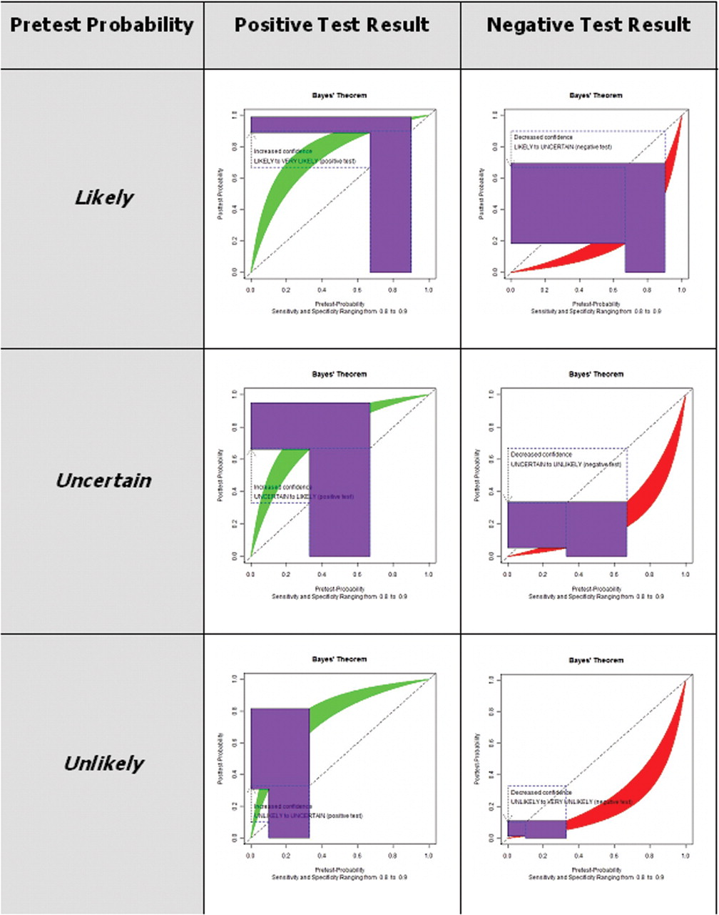
Medical diagnosis: Bayes’ theorem is applied in medical diagnoses to use data from previous cases and determine the probability of a patient having a certain disease. Bayesian inference allows for better prediction than traditional statistic methods because it can take into account all the factors that may affect an outcome and provide probabilities instead of just binary results. Bayes’ theorem is used to compute posterior probabilities, which are combined with clinical knowledge about diseases and symptoms to estimate the likelihood of a condition. Bayesian inference is used in the diagnosis of Alzheimer’s disease by analysing past patient data and finding a pattern that can indicate whether a person has this condition. Bayes’ theorem is especially useful for rare diseases that may occur infrequently and require a large amount of data to make accurate predictions.
Patterns in customer dataset/marketing campaign performance: Bayesian nonparametric clustering technique is used to find hidden patterns in data. Bayesian nonparametric clustering technique (BNC) is a powerful method that can be applied to various datasets such as customer datasets or marketing campaign performance. It helps find hidden patterns in data because Bayesian machine learning does not require any assumptions about the distribution of input variables. BNC enables you to find clusters that are statistically significant and can be generalized across other datasets as well.

Slide 16
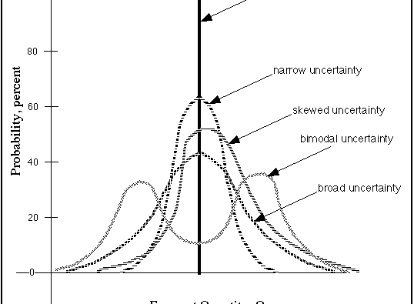
Reconstructing clean images from noisy images: Bayes’ theorem is used in Bayesian inverse problems such as Bayesian tomography. Bayesian inference can be applied to the problem of reconstructing images from noisy versions of those images using Bayes’ theorem and Markov Chain Monte Carlo (MCMC) algorithms.
Weather prediction: Bayesian inference can be used in Bayesian machine learning to predict the weather with more accuracy. Bayes’ theorem can be applied for predicting real-time weather patterns and probabilities of rain based on past data such as temperature, humidity, etc. Bayesian models compare favourably against classical approaches because they take into account the historical behaviour of the system being modelled and provide a probability distribution over the possible outcomes of the forecast.

Slide 17
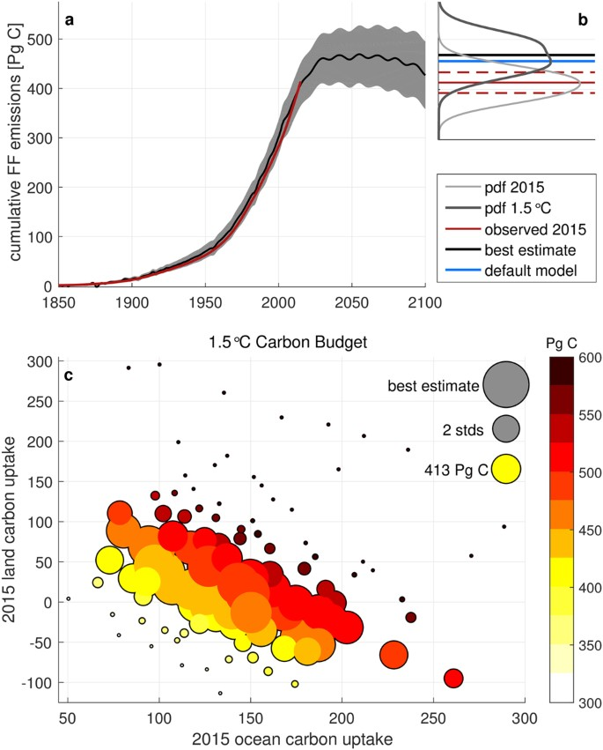
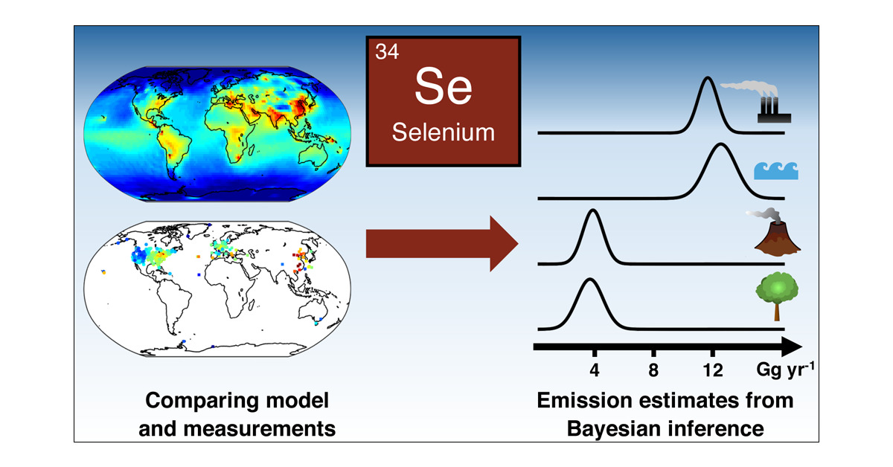
Speech emotion recognition: Nonparametric hierarchical neural network (NHNN), a lightweight hierarchical neural network model based on Bayesian nonparametric clustering (BNC), can be used to recognize emotions in speech with better accuracy. NHNN models generally outperform the models with similar levels of complexity and state-of-the-art models in within-corpus and cross-corpus tests. Through clustering analysis, it is shown that the NHNN models are able to learn group-specific features and bridge the performance gap between groups.
Estimating gas emissions: The recent findings suggest that a large fraction of anthropogenic methane emissions is represented by abnormal operating conditions of oil and gas equipment. As such, effective mitigation requires rapid identification as well as repairs for faulty sources controlled via advanced sensing technology or automatic fault detection algorithms based on recursive Bayes’ techniques.

Slide 18
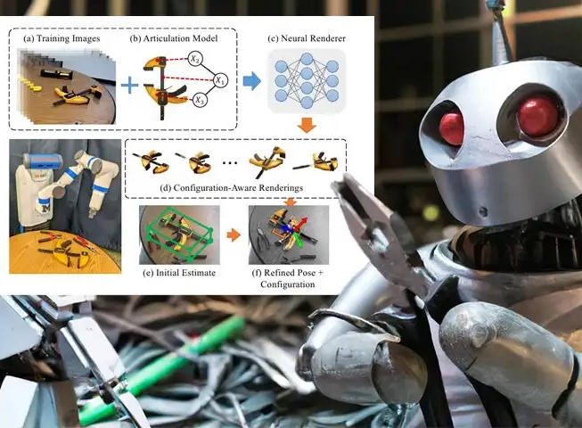
Help robots make decisions: Bayesian inference is used in robotics to help robots make decisions. Bayes’ theorem can be applied by using real-time sensor information from the robot’s environment and inferring about its next move or action based on previous experiences. Robots will use Bayes’ theorem for extracting relevant features such as speed, the direction of movement, obstacles, and other objects in the environment. Bayesian reinforcement learning can be applied to robot learning. Bayesian reinforcement learning (BRL) uses Bayes’ theorem to compute the probability of taking a certain action based on previously learned experiences/knowledge and observations received from sensory information. BRL has been shown to outperform other machine learning algorithms such as deep Q-learning, Monte Carlo Tree Search, and Temporal Difference Learning.
Optical character recognition (OCR): Bayesian inference can be used in Bayesian machine learning to improve optical character recognition (OCR) performance. Bayes’ theorem is applied for OCR, which involves the transformation of images captured on paper-based media into text strings that are computer-readable. Bayesian approaches have been shown to provide more accurate results compared with conventional machine learning algorithms.

Slide 19
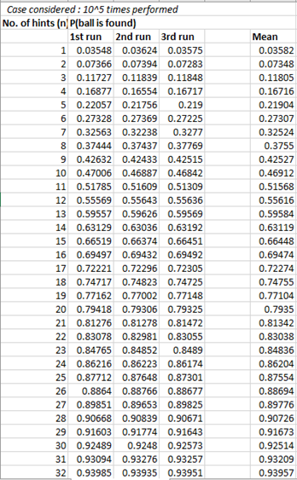
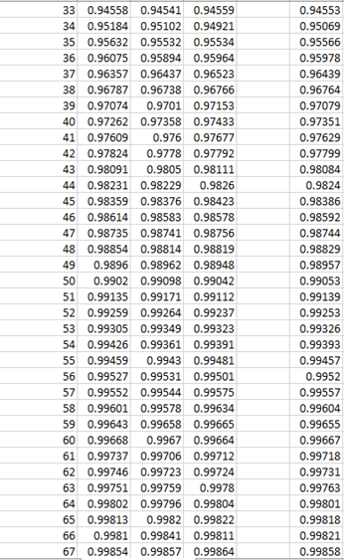
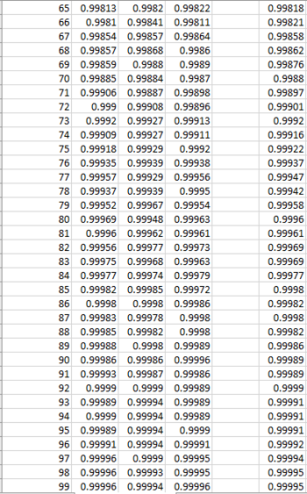
observations from the activity are as follows (recorded with the assistance of programming):

Slide 20
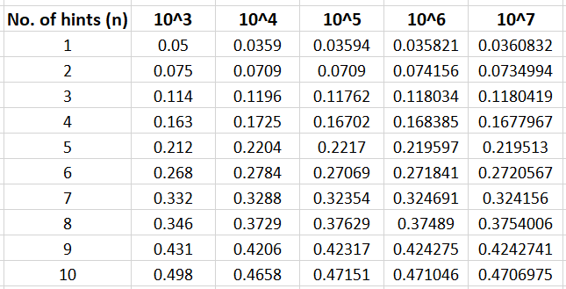
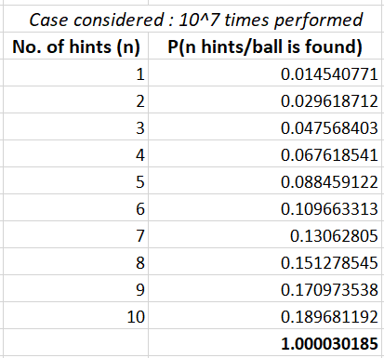
Given above are Results obtained by performing the activity multiple times with the help of python program. Python code developed in order to perform activity multiple times to record most probable observations is as follows:

Slide 21
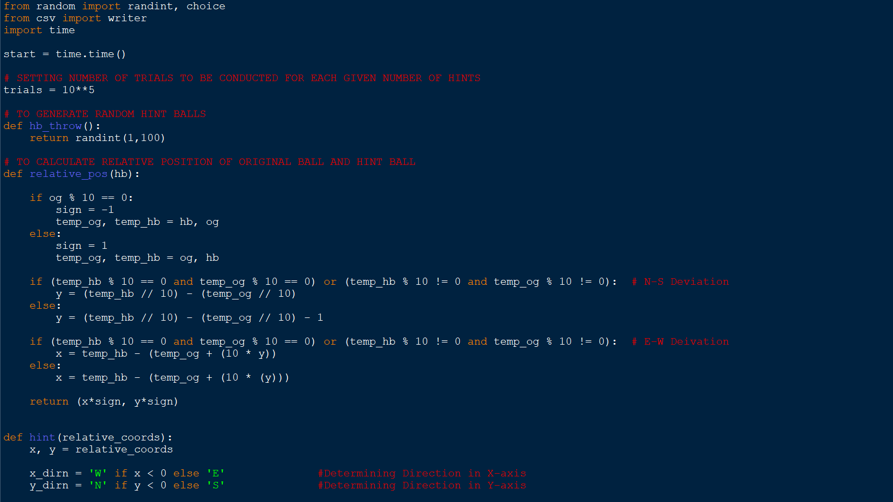

Slide 22
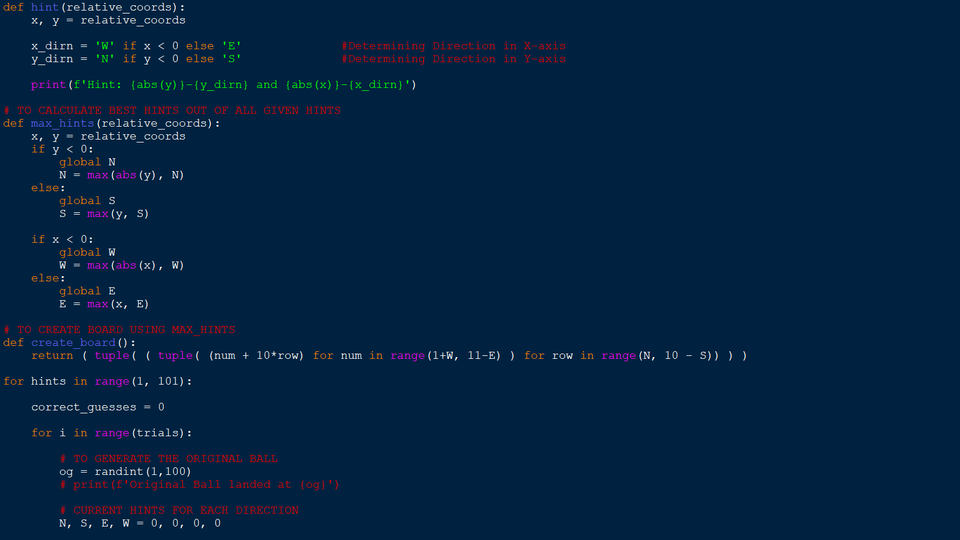

Slide 23
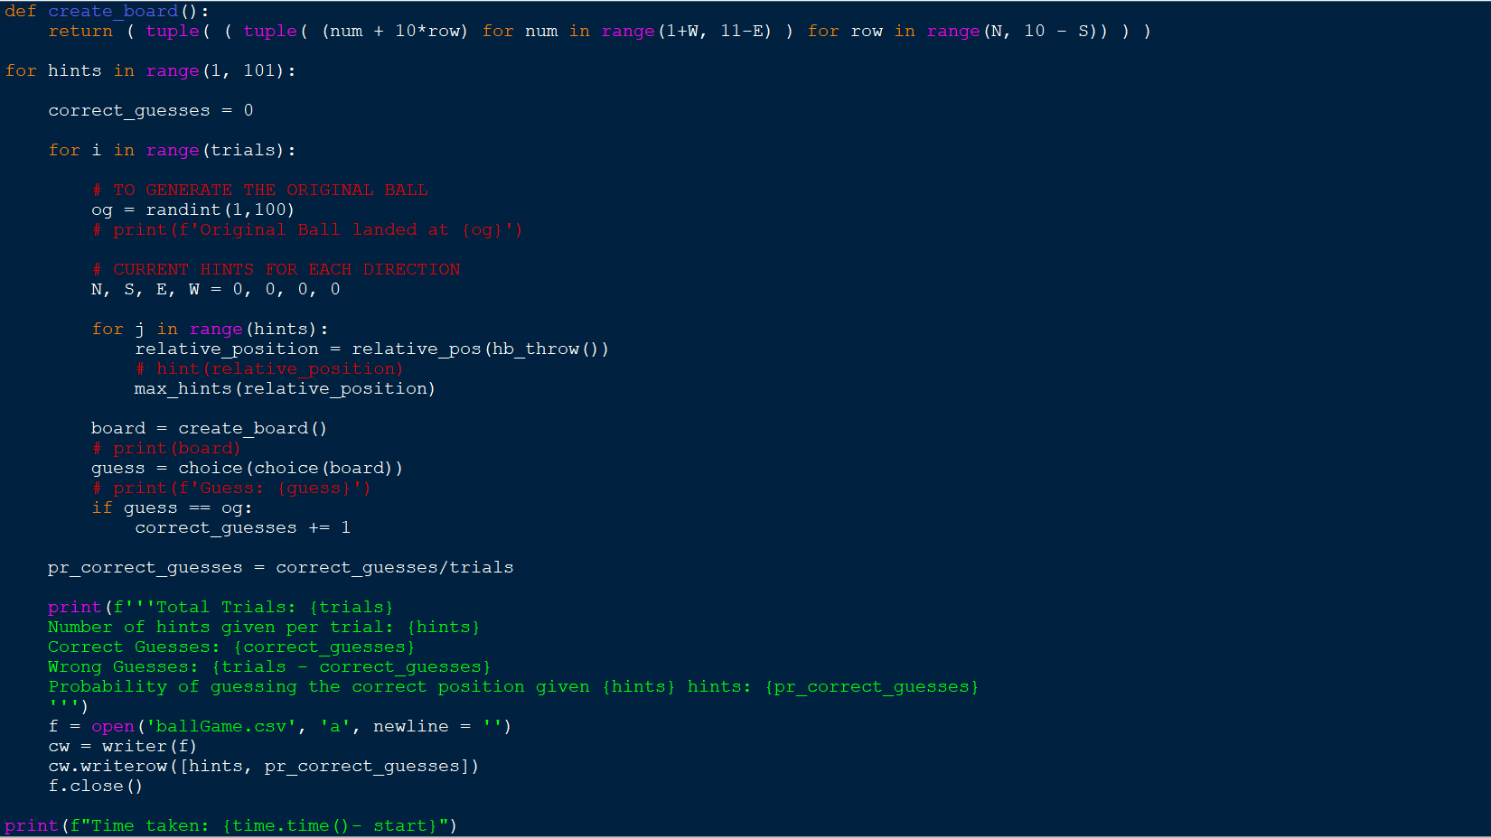

Slide 24
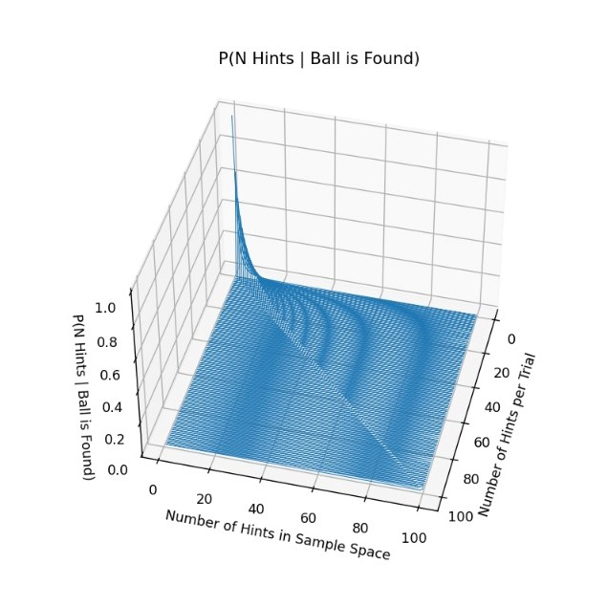
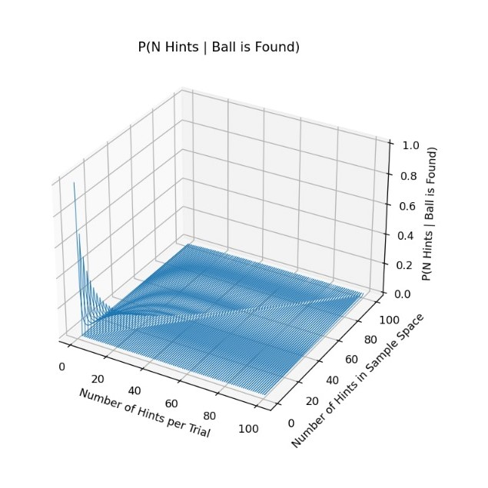
Graph drawn on the basis of the results inferred from observations drawn by performing the activity multiple times

Slide 25
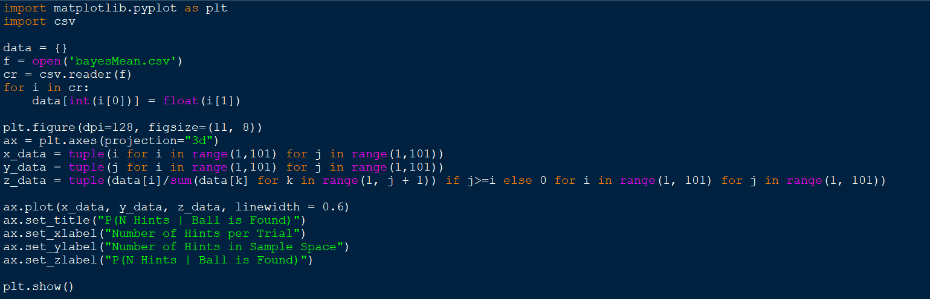
Python code developed in order to plot the graph based on the most probable observations is as follows:

Slide 26
bibliography
https://en.wikipedia.org/wiki/Bayes%27_theorem
https://www.youtube.com/watch?v=7GgLSnQ48os
https://www.youtube.com/watch?v=HZGCoVF3YvM
https://en.wikipedia.org/wiki/Conditional_probability
https://medium.com/analytics-vidhya/bayes-theorem-using-venn-diagrams-681b71ac450d
https://medium.com/analytics-vidhya/bayes-theorem-using-venn-diagrams-681b71ac450d
https://www.youtube.com/watch?v=-P1aWTw09yY&list=PL2usakk0oeFb6y-pqBhHJT02MOzecyQUs
https://www.youtube.com/watch?v=uRcs36-VXXw

Slide 27
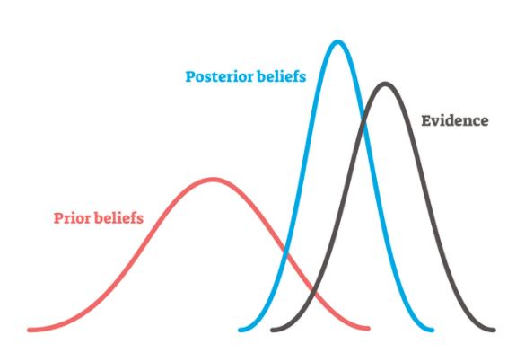
Conclusion
When event outcomes map naturally onto conditional probabilities, Bayes' theorem provides an intuitive method of reasoning and convenient computation. It allows us to combine prior knowledge with observations to make predictions about the phenomenon under study. In Bayesian inference, all unknowns in a system are modeled by probability distributions that are updated using Bayes' theorem as evidence accumulates.
Thank You !

